Slide 2
The Pathways guide to commitment
Michael Clancy (someone who is not Carole!)

Slide 3
When do I choose
Do your Ice breaker.
Get use to Pathways.
Start Planning,
Map out your goals.
Choose while you do your Evaluation Speeches and Research & Presenting
VPE/Base Camp managers must sign off speeches before you continue

Slide 4
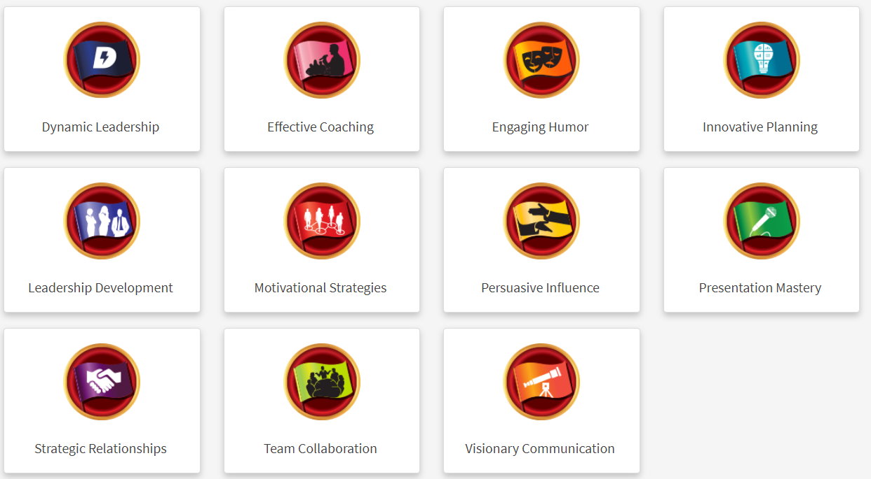
The Paths Explained

Slide 5
Purpose |  | Projects
Mastering Fundamentals |  | “Ice Breaker” “Evaluation and Feedback” “Researching and Presenting”
Learning Your Style |  | Two required projects +“Introduction to Toastmasters Mentoring”
Increasing Knowledge |  | One required project + a minimum of two elective projects *Serve as Topics master, Toastmaster and evaluator by the end of Level 3
Building Skills |  | One required project + a minimum of one elective project
Demonstrating Expertise |  | One required project + a minimum of one elective project+ “Reflect on Your Path

Slide 6
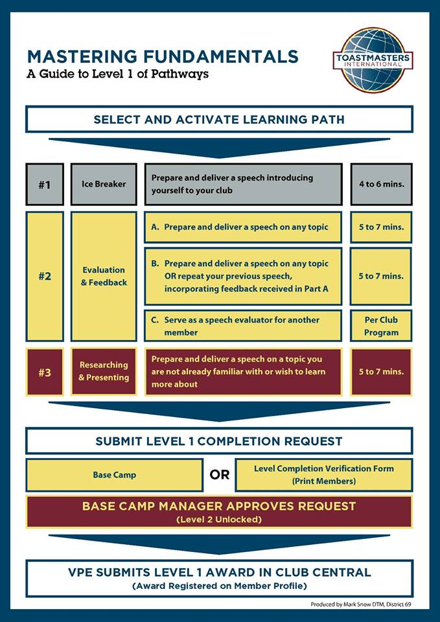
Mastering Fundamentals
Ice Breaker
Evaluation & Feedback
Speech Evaluation
Research & Planning

Slide 7
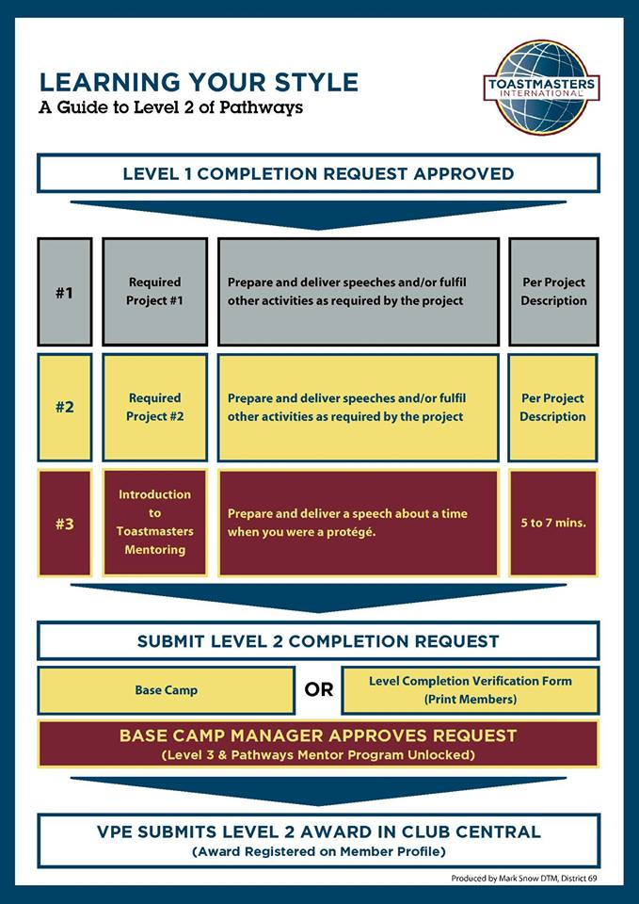
Learning Your Style
Required Project
Required Project
Introduction to Toastmasters Mentoring

Slide 8
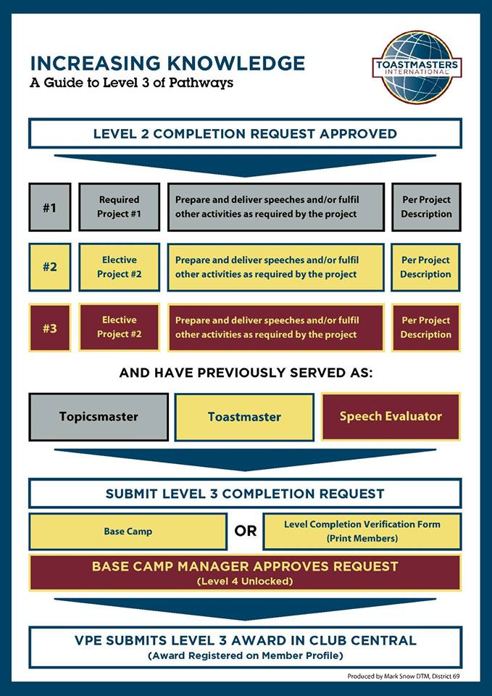
Increasing Knowledge
Required Project
Elective Project 1
Elective Project 2
Other Roles
Toastmaster
Topics Master
Speech Evaluator

Slide 9
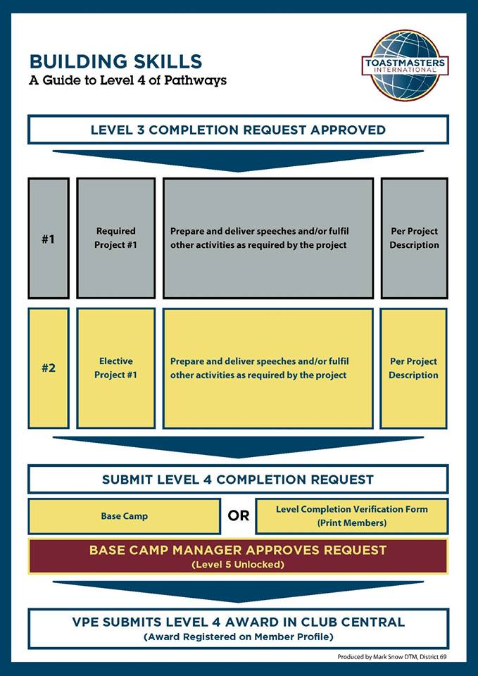
Building Skills
Required Project
Elective Project

Slide 10
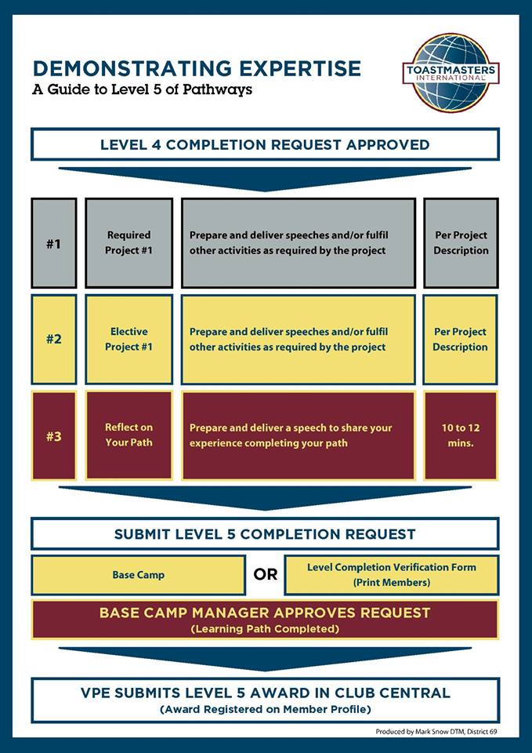
Demonstrating Expertise
Required Project
Elective Project
Reflect on Your Path

Slide 11
Projects for all Paths
Common:
Elective:
Level 3,4,5
4 Electives
Multiple Choices
Your Choice
May choose to do more
Unique:
Level 2,3,4,5
5 Projects
Each is Mandatory
May be done in multiple Paths
May be elective in other Paths
Level 1,2,5
5 Common Projects
Each is Mandatory
Same in Every Path
All of level 1

Slide 12
All Paths – Common Projects
Level 1:
Icebreaker
A 4- to 6-minute speech
Level 1:
Evaluation & Feedback
Level 2:
Introduction to Mentoring
A 5- to 7-minute speech
Level 5:
Reflect on Your Path
A 10- to 12-minute speech
A 5- to 7-minute speech
Incorporating feedback from your first speech into a second 5- to 7-minute speech
Serving as a speech evaluator
Research & Presenting
A 5- to 7-minute speech

Slide 13
All Paths – Elective Projects
Level 3:
Two Electives
13/14 Choices
Level 4:
One Elective
7/8 Choices
Level 5:
One Elective
5/6 Choices

Slide 14
All Paths – Targeted Mandatory Projects
Level 2:
2 Projects
Level 3:
1 Project
Level 4:
1 Project
Level 5:
1 Major Project

Slide 15
Additional Tasks for all Paths
Toastmaster
Topics Master
Before completion of Level 3
Speech Evaluator
Before completion of Level 3
Before completion of Level 3

Slide 16
Path Review
Elephant in the room
Dinosaurs and Change
Mythical Promises
Robots and Modernisation

Slide 17
Path Overview
What this path aims to do
What are the projects on this path focusing on
What do the projects emphasize as important
What is the major project. Level 5

Slide 18
Dynamic Leadership
This path helps you build your skills as a strategic leader.
The projects on this path focus on understanding leadership and communication styles, the effect of conflict on a group and the skills needed to defuse and direct conflict.
These projects emphasize the development of strategies to facilitate change in an organization or group, interpersonal communication and public speaking.
This path culminates in a project focused on applying your leadership skills.

Slide 19
Dynamic Leadership – Mandatory Projects
Level 2:
Understanding Your Leadership Style
A 5- to 7-minute speech
Understanding Your Communication Style
A 5- to 7-minute speech
Level 3:
Negotiate the Best Outcome
A 5- to 7-minute speech
Level 4:
Manage Change
A 5- to 7-minute speech
Level 5:
Lead in any Situation
Serving in a leadership role for a minimum of six months
An 8- to 10-minute speech
A Communication Plan
A 360° evaluation

Slide 20
Effective Coaching
This path helps you build your skills as a positive communicator and leader.
The projects on this path focus on understanding and building consensus, contributing to the development of others by coaching and establishing strong public speaking skills.
Each project emphasizes the importance of effective interpersonal communication.
This path culminates in a “High Performance Leadership” project of your design.

Slide 21
Effective Coaching – Mandatory Projects
Level 2:
Understanding Your Leadership Style
A 5- to 7-minute speech
Understanding Your Communication Style
A 5- to 7-minute speech
Level 3:
Reaching consensus
Leading a non-Toastmasters group toward consensus
Level 4:
Improvement Through Positive Coaching
Coaching an individual through a project
A 5- to 7-minute speech
Level 5:
High Performance Leadership
Forming and meeting with a guidance committee at least five times
Two 5- to 7-minute speeches
A 5- to 7-minute speech
A Project Plan
A Vision Plan
A 360° evaluation

Slide 22
Engaging Humor
This path is designed to help you build your skills as a humorous and engaging public speaker.
The projects on this path focus on understanding your sense of humor and how that sense of humor translates to engaging audience members.
The projects contribute to developing an understanding of how to effectively use humor in a speech, including challenging situations and impromptu speeches.
This path culminates in an extended humorous speech that will allow you to apply what you learned

Slide 23
Engaging Humor – Mandatory Projects
Level 2:
Know Your Sense of Humor
A 5- to 7-minute speech
Connect with Your Audience
A 5- to 7-minute speech
Level 3:
Engage Your Audience With Humor
A 5- to 7-minute speech
Level 4:
The Power of Humor in an Impromptu Speech
Two 2- to 3-minute impromptu speeches
Level 5:
Deliver Your Message With Humor
An 18- to 22-minute keynote-style humorous speech

Slide 24
Innovative Planning
This path helps you build your skills as a public speaker and leader.
The projects on this path focus on developing a strong connection with audience members when you present, speech writing and speech delivery.
The projects contribute to building an understanding of the steps to manage a project, as well as creating innovative solutions.
This path culminates in a “High Performance Leadership” project of your design.

Slide 25
Innovative Planning – Mandatory Projects
Level 2:
Understanding Your Leadership Style
A 5- to 7-minute speech
Connect With Your Audience
A 5- to 7-minute speech
Level 3:
Present a Proposal
A 5- to 7-minute speech
Level 4:
Manage Projects Successfully
A 5- to 7-minute speech about your experience
Level 5:
High Performance Leadership
Forming and meeting with a guidance committee at least five times
Two 5- to 7-minute speeches
Build a Team
A 2- to 3-minute speech about your plan
Creating a project plan
Deliver the Plan
A Project Plan
A Vision Plan
A 360° evaluation

Slide 26
Leadership Development
This path helps you build your skills as an effective communicator and leader.
The projects on this path focus on learning how to manage time, as well as how to develop and implement a plan.
Public speaking and leading a team are emphasized in all projects.
This path culminates in the planning and execution of an event that will allow you to apply everything you learned.

Slide 27
Leadership Development – Mandatory Projects
Level 2:
Managing Time
A 5- to 7-minute speech
Understanding Your Leadership Style
A 5- to 7-minute speech
Level 3:
Planning and Implementing
A 2- to 3-minute report or 5- to 7-minute speech
Level 4:
Leading Your Team
Building and leading a team to the completion of a project
A 5- to 7-minute speech
Level 5:
Manage Successful Events
Building a team
A 2- to 3-minute speech about your plan
A 5- to 7-minute speech
Completing the plan with your team

Slide 28
Motivational Strategies
This path helps you build your skills as a powerful and effective communicator.
The projects focus on learning understanding motivation and successfully leading small groups to accomplish tasks.
These projects also emphasize the development of strategies for building connections with the people around you
This path culminates in a comprehensive team-building project that brings all of your skills together—including public speaking.

Slide 29
Motivational Strategies – Mandatory Projects
Level 2:
Active Listening
Serving as Topics master at a club meeting
Understanding Your Communication Style
A 5- to 7-minute speech
Level 3:
Understanding Emotional Intelligence
A journal you maintain for a minimum of two weeks
A 5- to 7-minute speech
Level 4:
Motivate Others
Building and motivating a team to complete a project that benefits your club
A 5- to 7-minute speech
Level 5:
Team Building
Working with a small team to design and host a team-building event
A 2- to 3-minute report
A 5- to 7-minute speech

Slide 30
Persuasive Influence
This path helps you build your skills as a strategic leader.
The projects on this path focus on understanding leadership and communication styles, the effect of conflict on a group and the skills needed to defuse and direct conflict.
These projects also emphasize the development of strategies to facilitate change in an organization or group, interpersonal communication and public speaking.
This path culminates in a project focused on applying your leadership skills.

Slide 31
Persuasive Influence – Mandatory Projects
Level 2:
Active Listening
Serving as Topics master at a club meeting
Understanding Your Leadership Style
A 5- to 7-minute speech
Level 3:
Understanding Conflict Resolution
A 5- to 7-minute speech
Level 4:
Leading in Difficult Situations
Designing a detailed project plan
A 5- to 7-minute speech to share your plan
An impromptu speech to present solutions to disruptions (15-20 mins Speech)
Level 5:
High Performance Leadership
Forming and meeting with a guidance committee at least five times
Two 5- to 7-minute speeches
A Project Plan
A Vision Plan
A 360° evaluation
Plan Disruption Ideas

Slide 32
Presentation Mastery
This path helps you build your skills as an accomplished public speaker.
The projects on this path focus on learning how an audience responds to you and improving your connection with audience members.
The projects contribute to developing an understanding of effective public speaking technique, including speech writing and speech delivery.
This path culminates in an extended speech that will allow you to apply what you learned.

Slide 33
Presentation Mastery – Mandatory Projects
Level 2:
Effective Body Language
A 5- to 7-minute speech
Understanding Your Communication Style
A 5- to 7-minute speech
Level 3:
Persuasive Speaking
A 5- to 7-minute speech
Level 4:
Managing a Difficult Audience
A 5- to 7-minute speech
Level 5:
Prepare to Speak Professionally
An 18- to 22-minute keynote-style speech
The process of speaking and responding to audience members will take 12 to 15 minutes.
Role Play Disruptions

Slide 34
Strategic Relationships
This path helps you build your skills as a leader in communication.
The projects on this path focus on understanding diversity, building personal and/or professional connections with a variety of people and developing a public relations strategy.
Communicating well interpersonally and as a public speaker is emphasized in each project.
The path culminates in a project to apply your skills as a leader in a volunteer organization.

Slide 35
Strategic Relationships – Mandatory Projects
Level 2:
Cross-Cultural Understanding
A 5- to 7-minute speech
Understanding Your Leadership Style
A 5- to 7-minute speech
Level 3:
Make Connections Through Networking
Attending a networking event
A 5- to 7-minute speech
Level 4:
Public Relations Strategies
A public relations strategy
Level 5:
Leading in Your Volunteer Organization
Serving in a volunteer leadership role for a minimum of six months
A 5- to 7-minute speech
A Succession Plan
A 360° Evaluation
A 5- to 7-minute speech

Slide 36
Team Collaboration
This path helps you build your skills as a collaborative leader.
The projects on this path focus on active listening, motivating others and collaborating with a team.
Each project contributes to building interpersonal communication and public speaking skills.
This path culminates in a project focused on applying your leadership skills.

Slide 37
Team Collaboration – Mandatory Projects
Level 2:
Active Listening
Serving as Topics master at a club meeting
Understanding Your Leadership Style
A 5- to 7-minute speech
Level 3:
Successful Collaboration
Working with a small team to make a collaborative decision for a small-scale event
A 5- to 7-minute speech
Level 4:
Motivate Others
Building and motivating a team to complete a project that benefits your club
A 5- to 7-minute speech
Level 5:
Lead in Any Situation
Serving in a leadership role for a minimum of six months
An 8- to 10-minute speech
A 360° evaluation

Slide 38
Visionary Communication
This path helps you build your skills as a strategic communicator and leader.
The projects on this path focus on developing your skills for sharing information with a group, planning communications and creating innovative solutions.
Speech writing and speech delivery are emphasized in each project.
This path culminates in the development and launch of a long-term personal or professional vision.

Slide 39
Visionary Communication–Mandatory Projects
Level 2:
Understanding Your Leadership Style
A 5- to 7-minute speech
Understanding Your Communication Style
A 5- to 7-minute speech
Level 3:
Develop a Communication Plan
A 5- to 7-minute speech
Level 4:
Manage Change
A Communication Plan
Level 5:
Develop Your Vision
Developing a vision and establishing a plan to implement it
Two 5- to 7-minute speeches
A 5- to 7-minute speech

Slide 40
Pathways - DTM
Two Paths Completed.
Leader in your Club. Serve as Club Officer in your Club for 12 Months
Club Extension. Sponsor a Club or Youth Leadership Program or Speechcraft
Leader in your District. Serve as a District Officer for 12 Months
Club Support.
Club Mentor or Club Sponsor
DTM Project. Plan and Complete a project that benefits an Organisation Create a Team, Goal and Plan A 5- to 7-minute speech to share your plan and vision A 8- to 10-minute speech reflecting on your success

Slide 41
Pathways Mentoring
Introduction to Toastmasters Mentoring
Mandatory level 2 in All Paths
Prepare to Mentor
Being a Toastmaster Mentor
No speech required
Mentoring
Mentor a protégé to a successful outcome
Advanced Mentoring
Apply Mentoring Skills
A 6-month commitment
A 5- to 7-minute speech
A 5- to 7-minute speech
A 5- to 7-minute speech
Work with VPE to mentor

